Slide 1
Server Controls

Slide 2
Introduction
Server Controls are the tags that are understood by the server. There are basically three types of server controls.
HTML Server Controls - Traditional HTML tags
Web Server Controls - New ASP. NET tags
Validation Server Controls - For input validation

Slide 3
ASP.NET HTML Server Controls
ASP.NET provides a way to work with HTML Server controls on the server side; programming with a set of controls collectively is called HTML Controls.
These controls are grouped together in the Visual Studio Toolbox in the the HTML Control tab. The markup of the controls are similar to the HTML control.
These controls are basically the original HTML controls but enhanced to enable server side processing.
HTML elements in ASP. NET files are, by default, treated as text. To make these elements programmable, add a runat="server" attribute to the HTML element. This attribute indicates that the element should be treated as a server control.

Slide 4

Note:
All HTML server controls must be within a <form> tag with the runat="server" attribute. The runat="server" attribute indicates that the form should be processed on the server. It also indicates that the enclosed controls can be accessed by server scripts.
The System.Web.UI.HtmlControls.HtmlControl base class contains all of the common properties. HTML server controls derive from this class.
For example, consider the HTML input control:

Slide 5
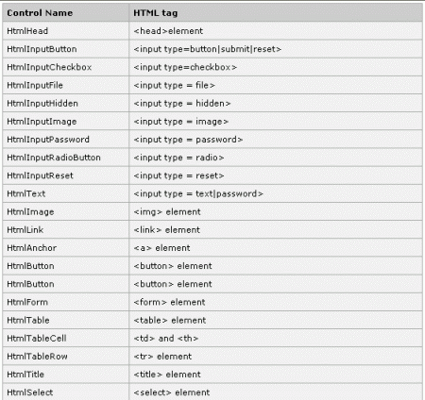

Slide 6
ASP.NET Web Server Controls
Web server controls are special ASP. NET tags understood by the server.
Like HTML server controls, Web server controls are also created on the server and they require a runat="server" attribute to work.
However, Web server controls do not necessarily map to any existing HTML elements and they may represent more complex elements.
Mostly all Web Server controls inherit from a common base class, namely the WebControl class defined in the System.Web.UI.WebControls namespace.

Slide 7
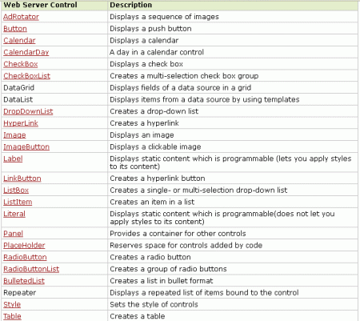

Slide 8
ASP.NET Validation Server Controls
After you create a web form, you should make sure that mandatory fields of the form elements such as login name and password are not left blank; data inserted is correct and is within the specified range. Validation is the method of scrutinizing (observing) that the user has entered the correct values in input fields.
A Validation server control is used to validate the data of an input control. If the data does not pass validation, it will display an error message to the user.

Slide 9
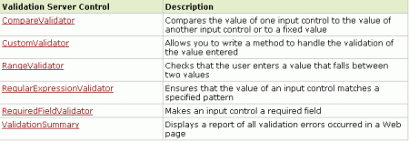
The syntax for creating a Validation server control is:

Slide 10
Server control file
Tutorial
https://www.youtube.com/watch?v=Fo__AqRCMIg
https://www.youtube.com/watch?v=Tkm4mC4IYGQ

